Slide 1
BME680 Air quality (Gas) sensor
Ryan McAdie
N01158072

Slide 2
Intro (Proposal)
BME680 to be later integrated with other group members sensors to help construct a greenhouse monitoring system. This system will be used to monitor live data such as:
- Temperature
- Humidity
- Soil Moisture Levels
- Air Quality
This system will be used by the faculty of the Humber Greenhouse and members of other plant nurseries who suffer from the lack of a proper greenhouse system.

Slide 3
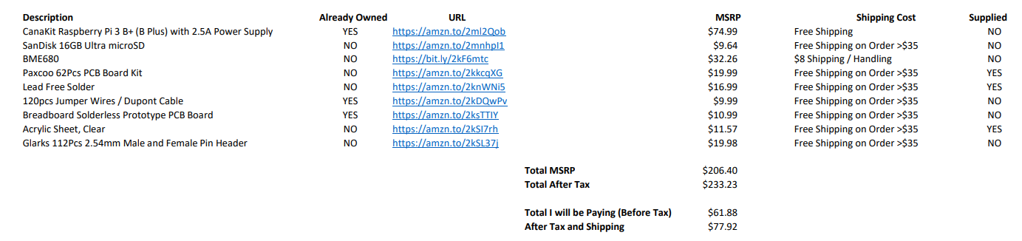
Budget

Slide 4
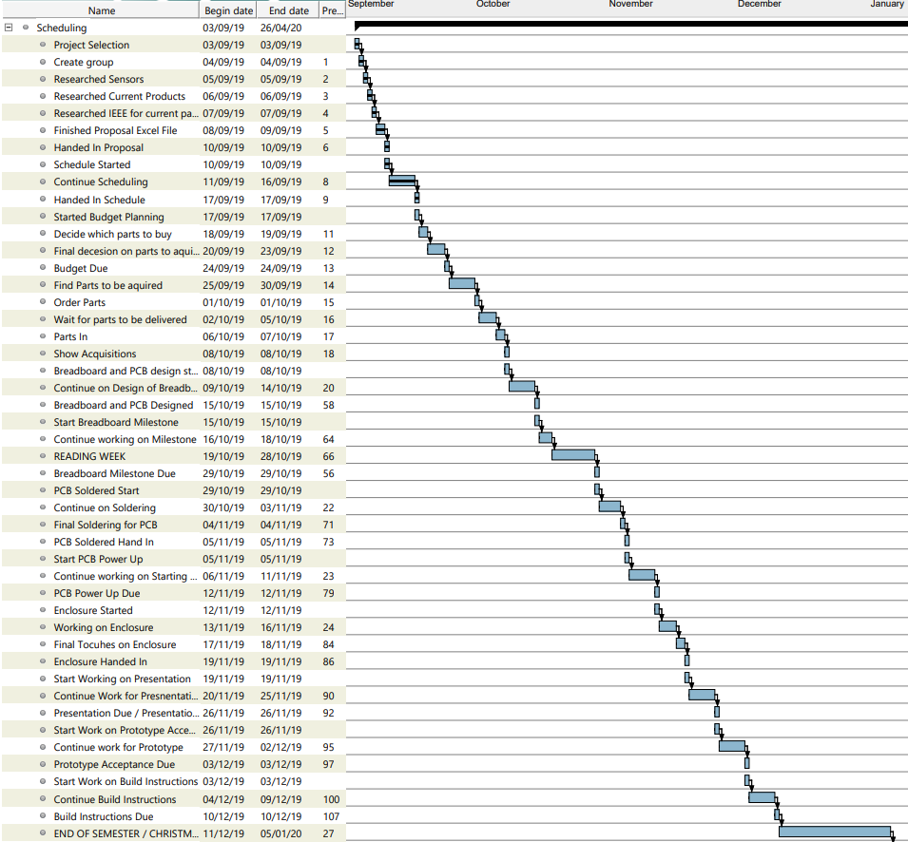

Schedule

Slide 5
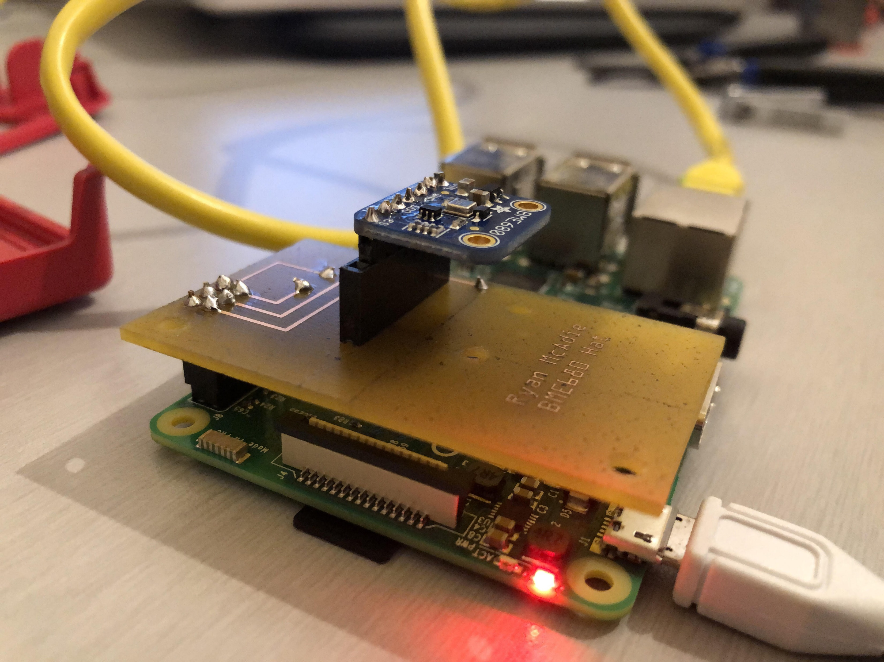
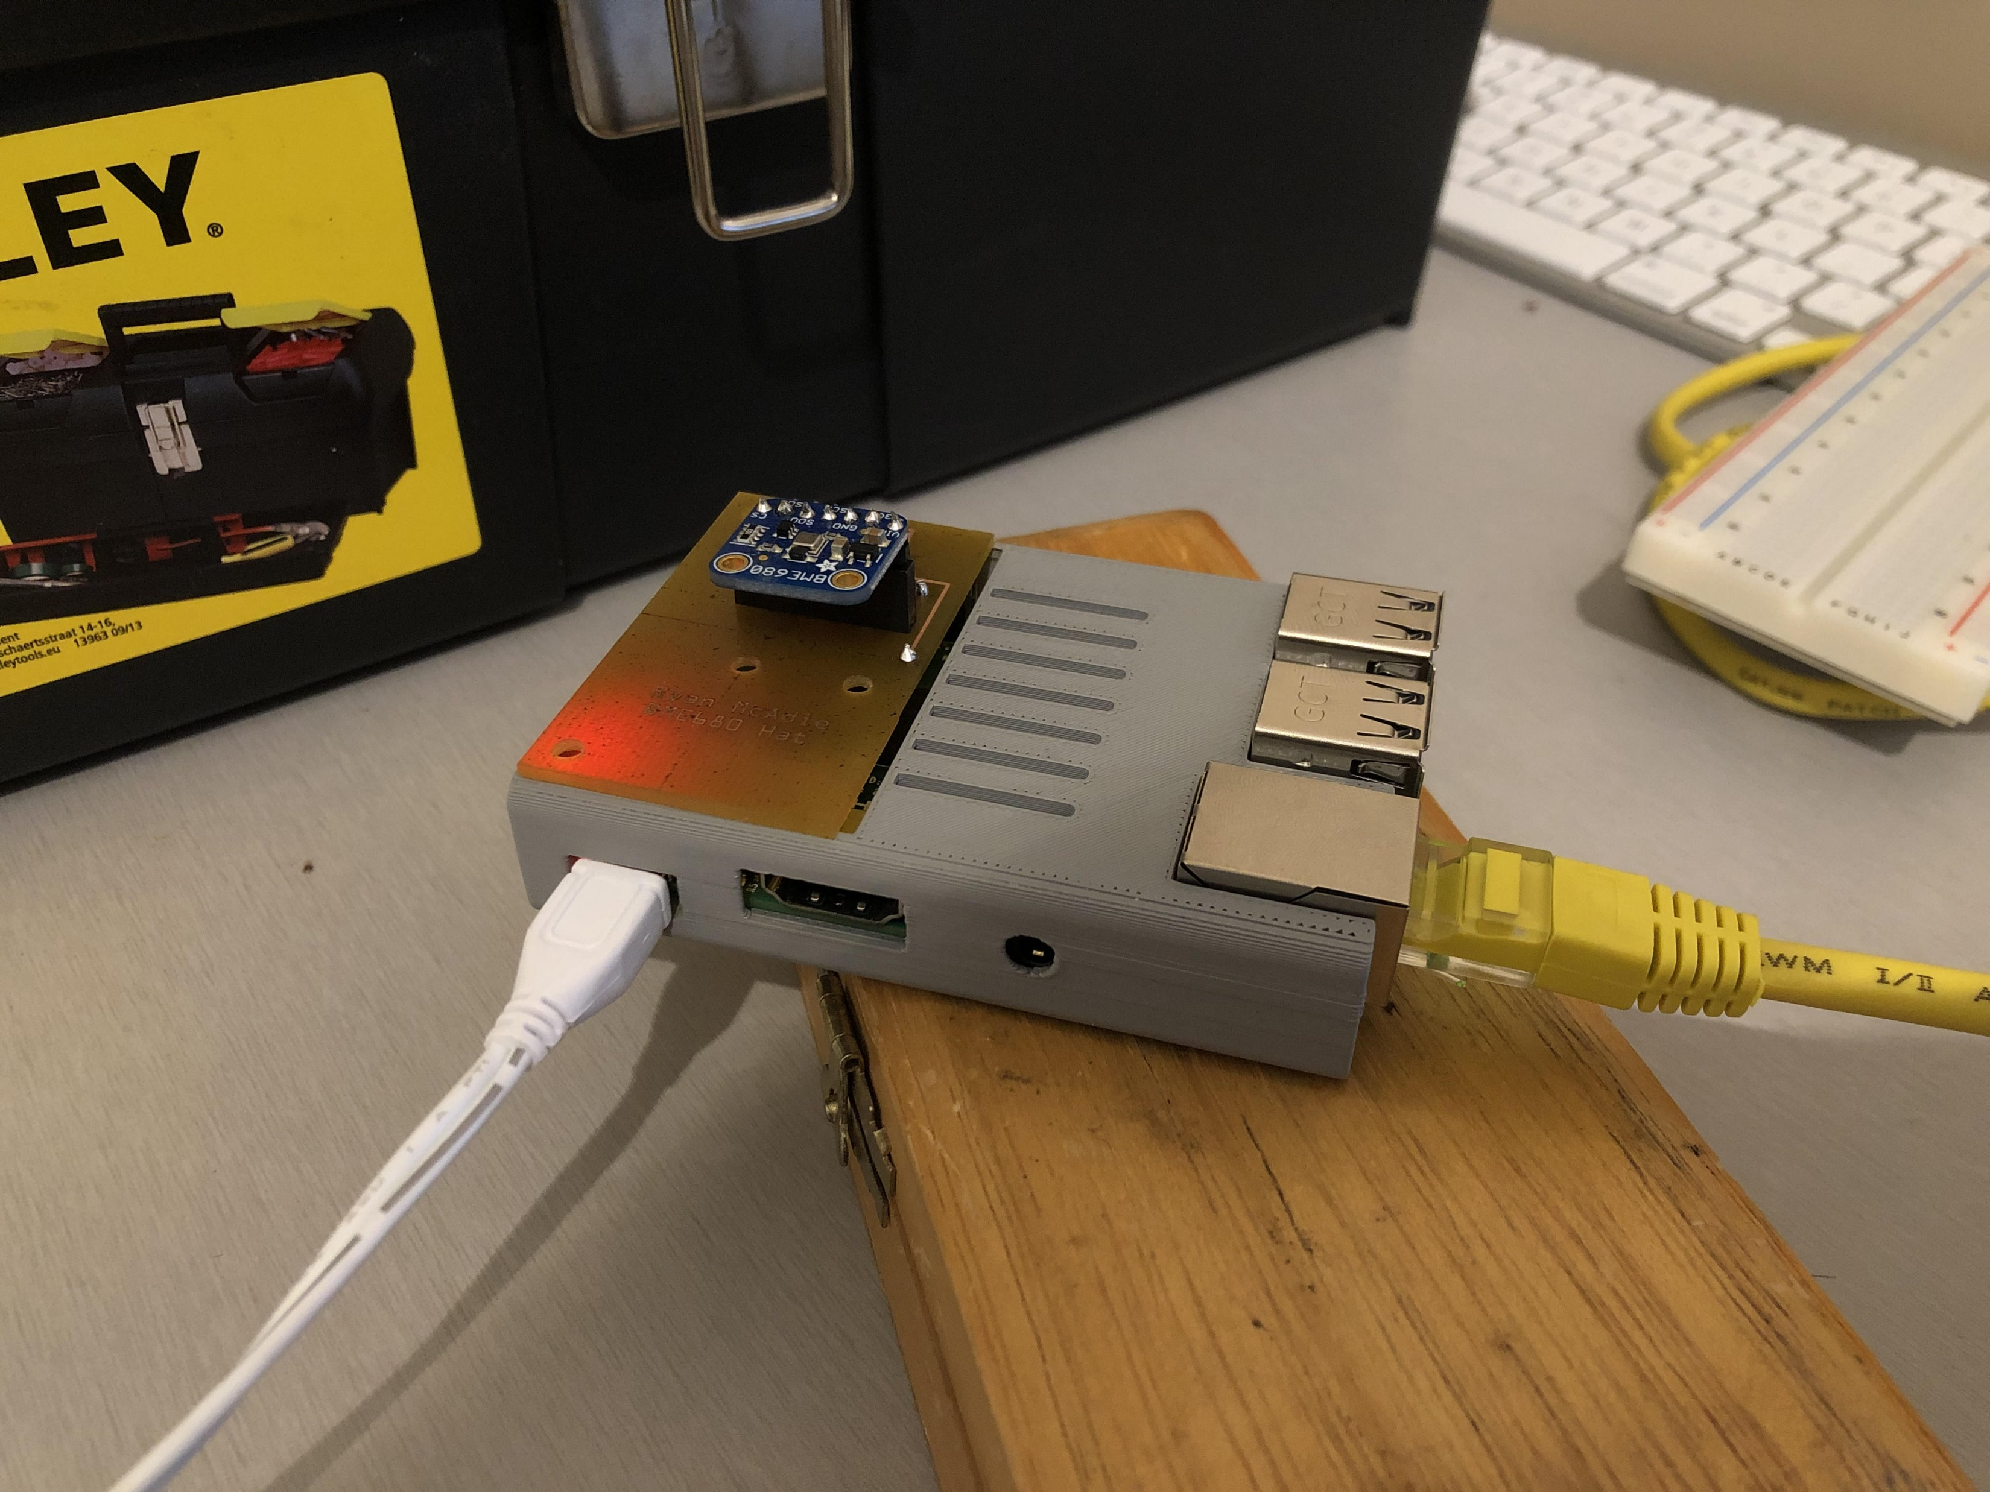
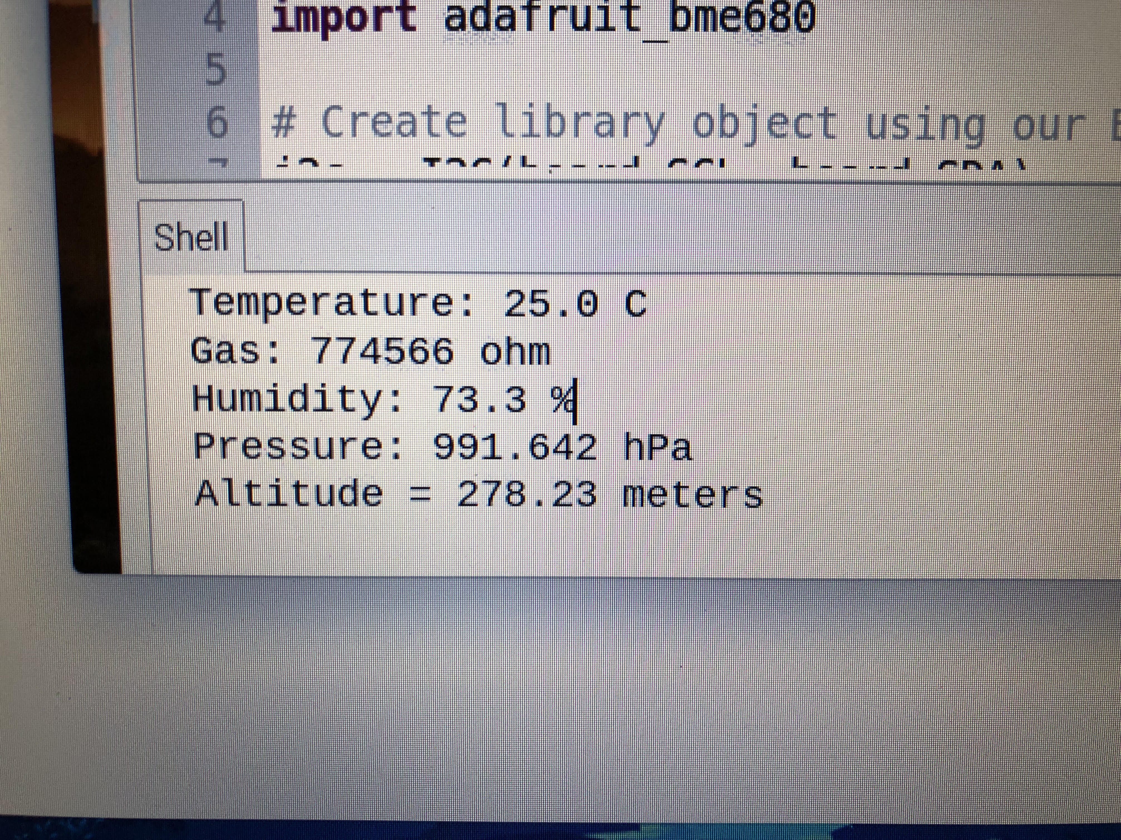
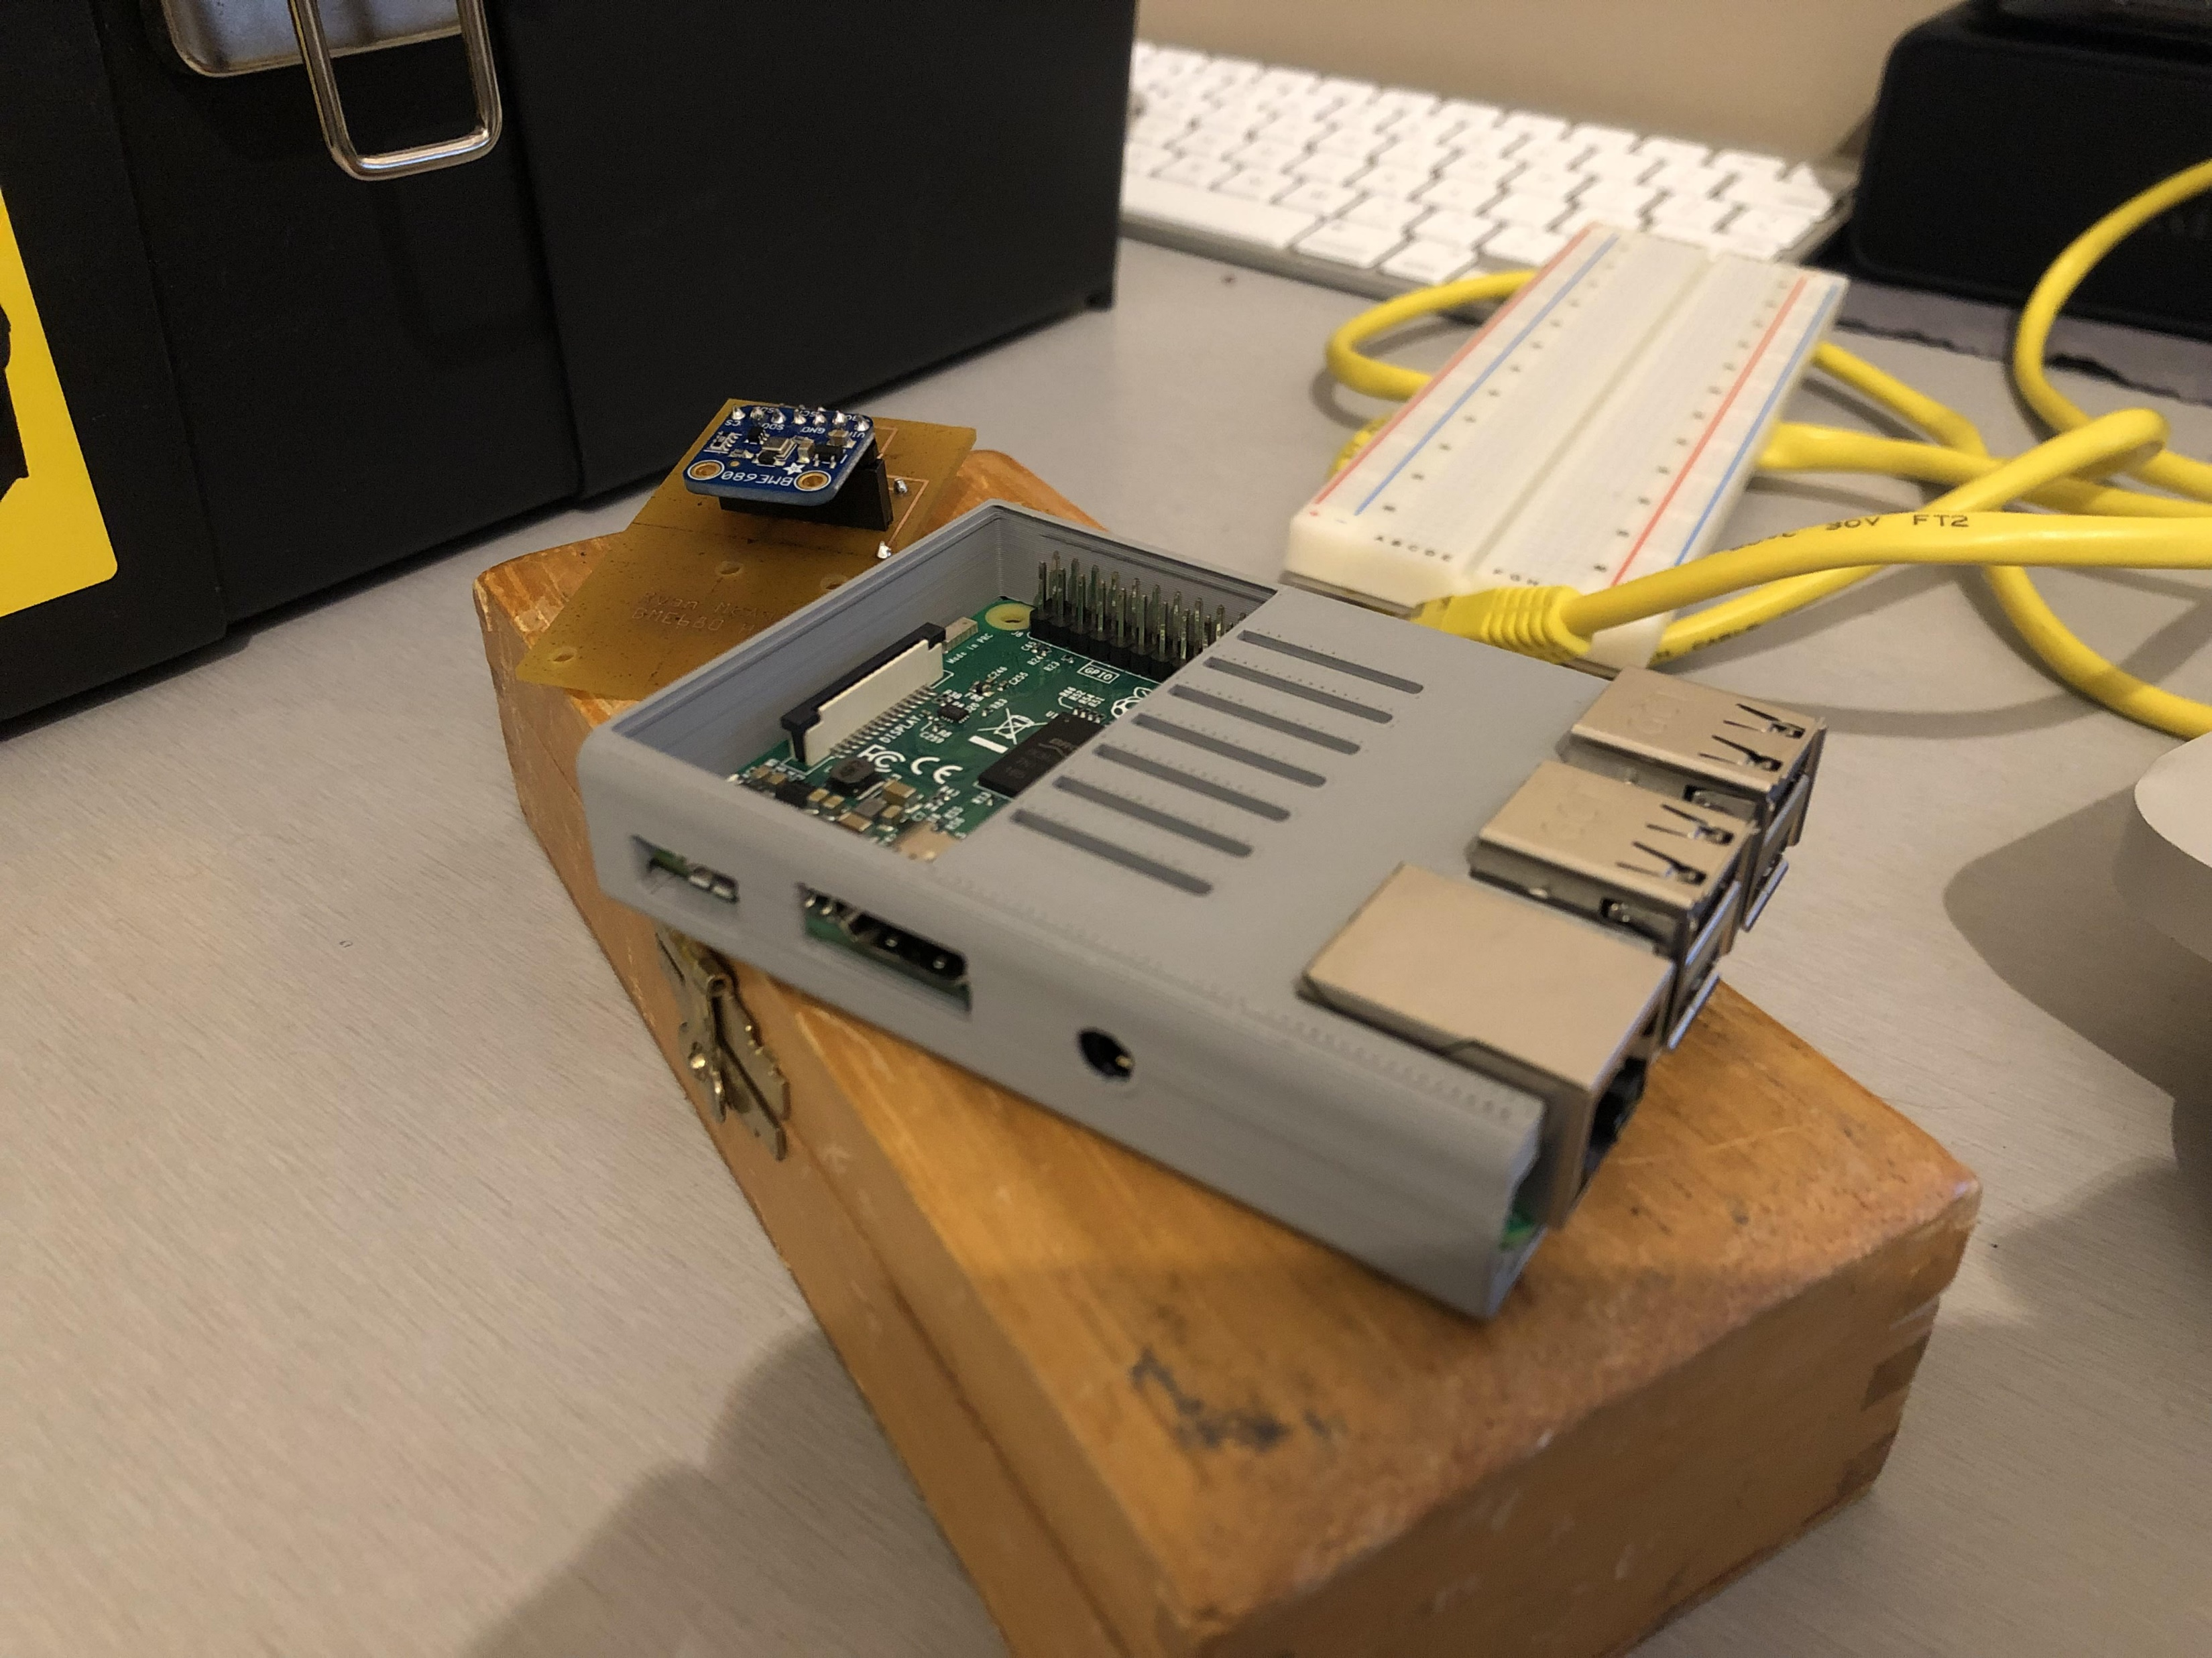
Images & sensor readings

Slide 6
Previous course knowledge
TECH 153 Technical C – using the Raspberry Pi GPIO pins to take in readings from the Humber sense hat
CENG252 Embedded Systems – working with remote desktop to Raspberry Pi, using the Raspberry Pi for development in a small scale system

